Slide 1
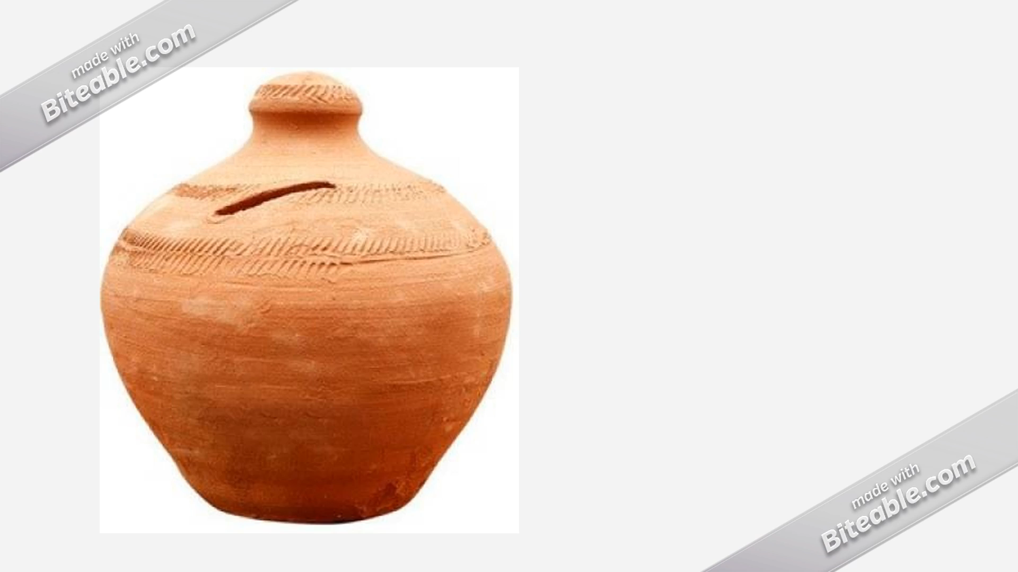

Slide 2
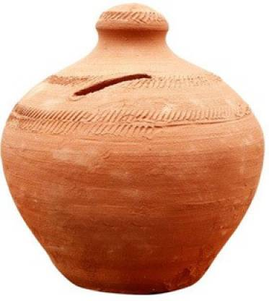
GULLAK-“SAVE&SAFE”
GULLAK – “SAVE AND SAFE” IS MICOSAVING PRODUCT TO CHANGE THE SAVING BEHAVIOUR AND PATTERN OF LESS SAVING PEOPLE.
Presented By:-
Nishant Kumar – M2020RG015

Slide 3


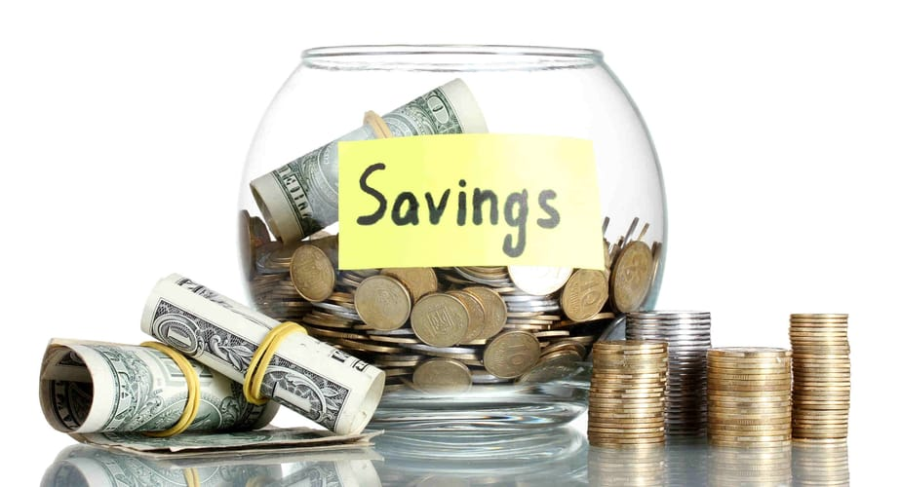
Micro-saving
WHY THE POOR DON’T SAVE MORE
Small deposit
Saving Brick By Brick
Multiplier Effect of saving
92% of our survey data has not any saving.
Hand to mouth
Shortsighted Behavior
- Gary Becker (Nobel economics laurate).
Life on Margin makes Poor Impatient.
EX > I
(Expenditure > Income)

Slide 4
Nudge Saving
Groups and community of Gullak frame Nudge of saving.
Showing Live Total Saving amount in the Gullak product and their benefits.
New scheme, Insurance and Help features of Gullak support Nudge saving.
1
2
3
Always Rational is not possible for Human being, we are influenced by our environment.
Nudge in Saving is very key point to change the behavior of poor Vendors to save more, through Gullak “Save and safe” Community or Groups.

Slide 5
Gullak – “Save and Safe”
ROSCAs(Rotating savings and credit association), a concept mostly used in village where association for saving and credits are formed.
Saving “Brick By Brick”, where person can save his money and avail credit according to his saving.
Collectors at village level has appointed to collect money and save in bank on the name of that group and individual in Gullak- save and safe Microsaving scheme.
ROSCA at pan level through digital platform and awareness.
Group and community in the ROSCAs Make nudging in saving and promote to save more in poor. This encourage us to use this group concept in digital Gullak microsaving product.
In Gullak Microsaving product, we are trying to use help from Digital platform to make community or group according to occupation and then that group save little amount on the daily or monthly basis through collector assigned by banks for this microsaving product.
Digital Revolution of Saving, a new method of ROSCAs.
- “Poor Economics” Written By Nobel laurate Abhijeet Banerjee and Esther Duflo.

Slide 6
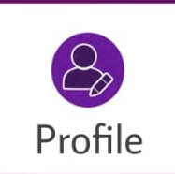
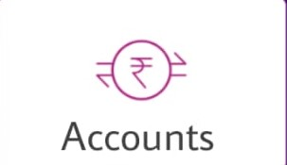
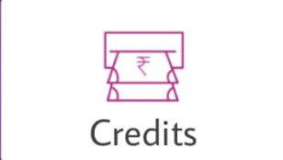
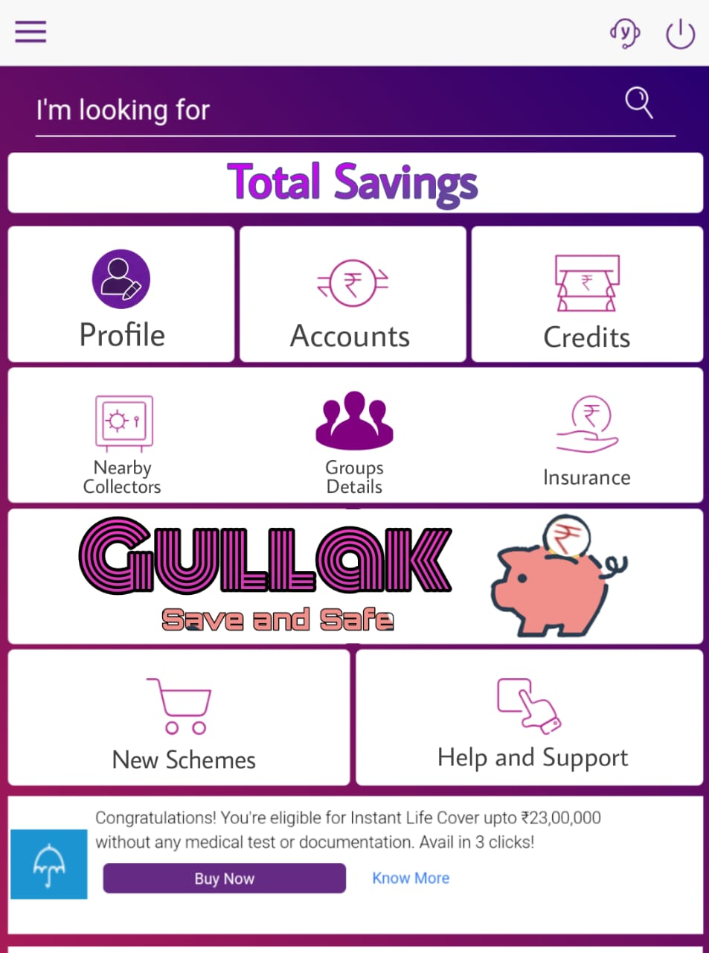
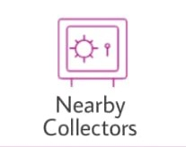

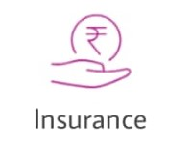
Interface of Gullak and features
Profile Has data of account and Personal data.
Account details and Saving details are here.
Credit details and how much credit you avail on your saving till now.
Share the awards and recognition awarded to him/her.
Collectors to collect saving from village or from individuals are appointed on commission basis from Bank.
Group details are the data of groups and their saving, one person can be in multiple groups.
Option for Insurance available in the portal at minimum cost.

Slide 7
Features of Gullak- “Save and Safe”
Groups and communities of same occupation: Help to Nudge the behavior of saving.
One member can be in multiple group: Help to save more.
Saving makes better credit opportunity: On your saving you can avail credit as happened in local clubs (SHG) of saving and credit goes to rotational basis.
Help and support: This makes transparency and effectiveness of this product.
Insurance schemes directly came under this product as per the occupation and eligibility. Which further acts as nudge for saving.
Nearby collectors are Jan seva kendra, general assigned worker from bank (Bank Mitra) to promote saving behavior.
Saving is art of management.
- N.K. Upadhyay

Slide 8
Credit Features
Credit is based on the saving of individual, as individual save more can avail more credit.
Overdraft Facilities (90%-95% of savings) can be introduced in our credit facility as on Microsaving.
then Overdraft facilities reduced the rate of interest of credit:
Interest= Interest of credit – interest of saving
Then interest could be range between (0.5%- 2.0%)
Credit is one of the feature of Gullak.

Slide 9
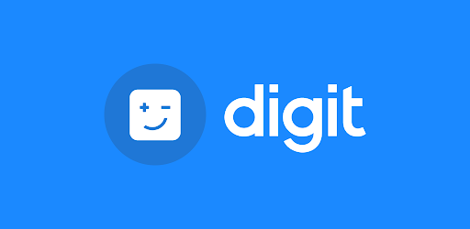
Benefits
Save Brick by Brick, which means saving small amount is possible through Gullak.
Microsaving has not seen much development in Digital platform, Gullak is way that connect you through Pan global community and groups who saved in traditional way through Clubs.
Similar occupational groups leads to growth in saving of individual due to competition in their similar business.
Digital Interface make saving more transparent, Efficient and promote feeling of saving.
Saving Acts as multiplier effect for getting credit and insurance.
All banks has similar, one common interface or one common product Gullak for all accounts which leads to one stage for all individual from different bank accounts.

Slide 10
Challenges and solutions
Less frequency of saving : More often it is seen that the frequency of saving decreases over a time, here this one is biggest challenge but we are trying to solve this problem through Nudging, where if any member of the group perform, this impact the behavior of whole group and all try to save more, as we find in local ROSCAs.
Digital complexity: Digital way might looks little bit complex but in our survey all of the vendors have android mobile phone which might change the behavior of complexity when they started using this product because of user friendly interface.
Fraud and Coercive Nature of Bank Mitra, to solve this problem bank assigned Bank Mitra as a agent to remove fraud as much as possible and coercive nature is handled through help desk of monthly or Quarterly feedback taken by help and support service directly from users.
Emergency credit from saving: In case of emergency through portal anyone can avail credit at any time and can withdraw from anywhere.

Slide 11
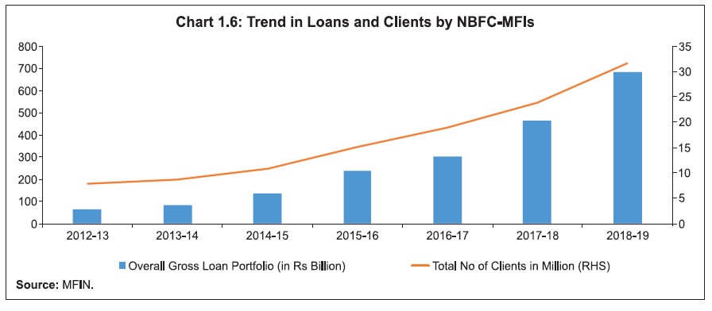
Policy and Regulation
In our Survey Saving is the core issue that’s why we design Microsaving product.
Regulatory Framework of Gullak:
- To save poor from Ponzi schemes, it will be regulated under Unregulated Deposit schemes 2019.
Agents are regulated under Bank Mitra Regulation.
Behavior of savers are regulated through Nudge methods .
MFI regulations to save the rights and to reduce the fraud in microfinance.
As in the graph here the growth of MFI in crediting seen double in last 10 year due to digital revolution, it is necessary to regulate the sector as there are large number of clints and one violation could be worse effect on poor life.
Regulatory Framwork of Gullak

Slide 12
Thank You
“Poverty is not just a lack of money; It is not having the capability to realize one’s full potential as a human being”
Abhijeet Banerjee (Nobel Prize winner Economics 2019)

